Slide 1
MEA UNIT-1
Managerial Economics

Slide 2
INTRODUCTION TO MANAGERIAL ECONOMICS
Introduction to Economics
Economics is a study of human activity both at individual and national level. Any activity involved in efforts aimed at earning money and spending this money to satisfy our wants such as food, Clothing, shelter, and others are called “Economic activities”.
It was only during the eighteenth century that Adam Smith, the Father of Economics, defined economics as the study of nature and uses of national wealth’.

Slide 3
Definition:
Dr. Alfred Marshall, one of the greatest economists of the nineteenth century, writes “Economics is a study of man’s actions in the ordinary business of life: it enquires how he gets his income and how he uses it”.
Prof. Lionel Robbins defined Economics as “the science, which studies human behavior as a relationship between ends and scarce means which have alternative uses”

Slide 4
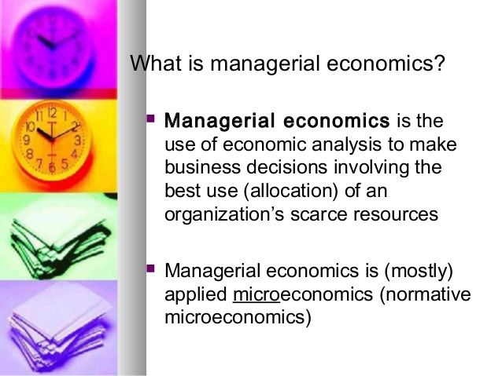

Slide 5
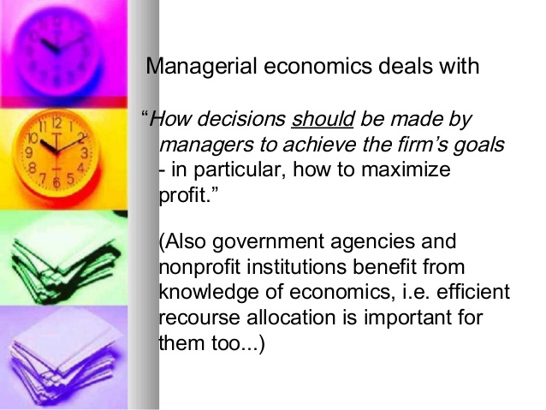

Slide 6
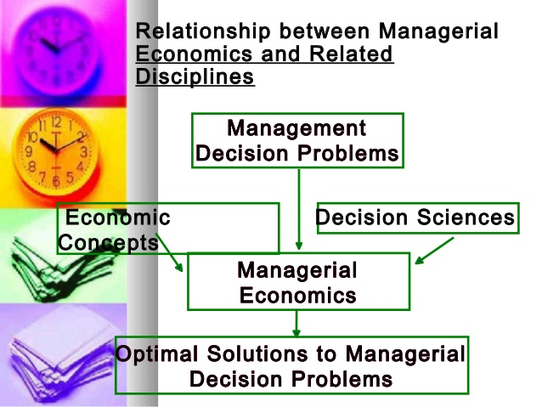

Slide 7
Microeconomics ➢
The study of an individual consumer or a firm is called microeconomics.
➢ Micro means ‘one millionth’.
➢ Microeconomics deals with behavior and problems of single individual and of micro organization.
➢ It is concerned with the application of the concepts such as price theory, Law of Demand and theories of market structure and so on.

Slide 8
Macroeconomics: ➢
The study of ‘aggregate’ or total level of economic activity in a country is called macroeconomics.
➢ It studies the flow of economics resources or factors of production (such as land, labor, capital, organization and technology) from the resource owner to the business firms and then from the business firms to the households.
➢ It is concerned with the level of employment in the economy.
➢ It discusses aggregate consumption, aggregate investment, price level, and payment, theories of employment, and so on.

Slide 9
Nature of managerial Economics:
1. Close to microeconomics : Managerial economics is concerned with finding the solutions for different managerial problems of a particular firm. Thus, it is more close to microeconomics.
2. Operates against the backdrop of macroeconomics : The macroeconomics conditions of the economy are also seen as limiting factors for the firm to operate.
In other words, the managerial economist has to be aware of the limits set by the macroeconomics conditions such as government industrial policy, inflation and so on.

Slide 10
3. Normative statements: • A normative statement usually includes or implies the words ‘ought’ or ‘should’. They reflect people’s moral attitudes and are expressions of what a team of people ought to do
• . Such statement are based on value judgments and express views of what is ‘good’ or ‘bad’, ‘right’ or ‘ wrong’.
• One problem with normative statements is that they cannot to verify by looking at the facts, because they mostly deal with the future. Disagreements about such statements are usually settled by voting on them.

Slide 11
4. Prescriptive actions:
• Prescriptive action is goal oriented.
• Given a problem and the objectives of the firm, it suggests the course of action from the available alternatives for optimal solution.
• It also explains whether the concept can be applied in a given context on not. For instance, the fact that variable costs are marginal costs can be used to judge the feasibility of an export order.

Slide 12
5. Applied in nature:
• ‘Models’ are built to reflect the real life complex business situations and these models are of immense help to managers for decision-making.
• The different areas where models are extensively used include inventory control, optimization, project management etc.
• In managerial economics, we also employ case study methods to conceptualize the problem, identify that alternative and determine the best course of action.

Slide 13
6. Offers scope to evaluate each alternative:
• Managerial economics provides an opportunity to evaluate each alternative in terms of its costs and revenue.
• The managerial economist can decide which is the better alternative to maximize the profits for the firm.
7. Interdisciplinary:
• The contents, tools and techniques of managerial economics are drawn from different subjects such as economics, management, mathematics, statistics, accountancy, psychology, organizational behavior, sociology and etc.

Slide 14
Scope of Managerial Economics:
Managerial economics refers to its area of study.
Managerial economics, Provides management with a strategic planning tool that can be used to get a clear perspective of the way the business world works and what can be done to maintain profitability in an ever-changing environment. .
Managerial economics is primarily concerned with the application of economic principles and theories to five types of resource decisions made by all types of business organizations.
a. The selection of product or service to be produced.
b. The choice of production methods and resource combinations.
c. The determination of the best price and quantity combination
d. Promotional strategy and activities.
e. The selection of the location from which to produce and sell goods or service to consumer

Slide 15
The scope of managerial economics covers two areas of decision making
• Operational or Internal issues
• Environmental or External issues

Slide 16
OPERATIONAL ISSUES:
Operational issues refer to those, which are within the business organization and they are under the control of the management. Those are:
1.Theory of demand and Demand Forecasting
2. Pricing and Competitive strategy
3. Production cost analysis
4. Resource allocation
5. Profit analysis
6. Capital or Investment analysis
7.Inventory Management
8. Strategic planning
9. Sales& Marketing strategies

Slide 17
Demand Analyses and Forecasting:
➢ Demand analysis also highlights for factors, which influence the demand for a product.
This helps to manipulate demand.
Thus demand analysis studies not only the price elasticity but also income elasticity, cross elasticity as well as the influence of advertising expenditure with the advent of computers.
➢ Demand forecasting has become an increasingly important function of managerial economics.
A firm can survive only if it is able to the demand for its product at the right time, within the right quantity.
Understanding the basic concepts of demand is essential for demand forecasting

Slide 18
2. Pricing and competitive strategy:
➢ Pricing decisions have been always within the preview of managerial economics.
Price theory helps to explain how prices are determined under different types of market conditions.
➢ Competitions analysis includes the anticipation of the response of competitions the firm’s pricing, advertising and marketing strategies. Product line pricing and price forecasting occupy an important place here.

Slide 19
3. Production and cost analysis:
➢ Production analysis is in physical terms.
➢ While the cost analysis is in monetary terms cost concepts and classifications, cost-output relationships, economies and diseconomies of scale and production functions are some of the points constituting cost and production analysis.

Slide 20
4. Resource Allocation:
➢ Managerial Economics is the traditional economic theory that is concerned with the problem of optimum allocation of scarce resources.
➢ Marginal analysis is applied to the problem of determining the level of output, which maximizes profit.
➢ In this respect linear programming techniques has been used to solve optimization problems. In fact lines programming is one of the most practical and powerful managerial decision making tools currently available.

Slide 21
5. Profit analysis:
➢ Profit making is the major goal of firms.
There are several constraints here an account of competition from other products, changing input prices and changing business environment hence in spite of careful planning, there is always certain risk involved.
➢ Managerial economics deals with techniques of averting of minimizing risks.
Profit theory guides in the measurement and management of profit, in calculating the pure return on capital, besides future profit planning.

Slide 22
6. Capital or investment analyses:
➢ Capital is the foundation of business. Lack of capital may result in small size of operations. Availability of capital from various sources like equity capital, institutional finance etc. may help to undertake large-scale operations.
➢ Hence efficient allocation and management of capital is one of the most important tasks of the managers.
➢ The major issues related to capital analysis are:
1.The choice of investment project
2.Evaluation of the efficiency of capital
3.Most efficient allocation of capital. Knowledge of capital theory can help very much in taking investment decisions. This involves, capital budgeting, feasibility studies, analysis of cost of capital etc.

Slide 23

7.Inventory management refers to the process of ordering, storing and using a company's inventory.
This includes the management of raw materials, components and finished products, as well as warehousing and processing such items
8. Strategic planning:
➢ Strategic planning provides a long-term goals and objectives and selects the strategies to achieve the same.
The perspective of strategic planning is global.
➢ strategic planning has given rise to be new area of study called corporate economics.

Slide 24
9.A marketing strategy involves long-term objectives for a company whereas the sales strategy is more short-term.
A marketing strategy involves how a company promotes and distributes the product, but the sales strategy includes how to get the particular customer to buy a product or service.

Slide 25
B. Environmental or External Issues:
They refer to general economic, social and political atmosphere within which the firm operates.
A study of economic environment should include: The type of economic system in the country.
a.. The general trends in production, employment, income, prices, saving and investment.
b. Trends in the working of financial institutions like banks, financial corporations, insurance companies
c. Magnitude and trends in foreign trade;
d. Trends in labour and capital markets;
e. Government’s economic policies viz. industrial policy monetary policy, fiscal policy, price policy etc

Slide 26
➢ The social environment refers to social structure as well as social organization like trade unions, consumer’s co-operative etc.
➢ The Political environment refers to the nature of state activity, chiefly states’ attitude towards private business, political stability etc.
➢ The environmental issues highlight the social objective of a firm i.e.; the firm owes a responsibility to the society. Private gains of the firm alone cannot be the goal.

Slide 27
Significance of Managerial economics
Theoretical Importance
To understand Economic behavior
To understand Whole economic system
Intellectual value
Economic tools
Economic growth and Development
Performance of the economy
Economic Planning
Can able to Predict
Business Ethics

Slide 28
Practical Significance
Useful to Finance Minister( public expenditure, public revenue and public debt)
Helpful for Ministers for Planning
For bankers
For Trade union leaders
For Businessman
For statesman
Solves international economic problems

Slide 29
Role of Managerial Economics
Obtaining information
Specific decisions like Demand forecasting, production scheduling, marketing research, price fixation
General Task
Internal factors like price fixation, inventory mgmt.
External like demand region-wise, sales forecasting
Must improve Economic intelligence through published and unpublished data
Must participate in public debates
Must analyze agricultural products
internal
external

Slide 30
Fundamental concepts of M.Es
Opportunity cost:
It is the value of something when a particular course of action is chosen. Simply put, the opportunity cost is what you must forgo in order to get something. The benefit or value that was given up can refer to decisions in your personal life, in a company, in the economy, in the environment, or on a governmental level.
Example:
1.Someone gives up going to see a movie to study for a test in order to get a good grade. The opportunity cost is the cost of the movie and the enjoyment of seeing it.
2.For a farmer choosing to plant corn, the opportunity cost would be any other crop he may have planted, like wheat or sorghum.
Opportunity cost should always be zero.

Slide 31
Incremental concept
Two basic concepts lie at the heart of incremental analysis, viz., incremental cost and incremental revenue. The former refers to the change in total cost resulting from a decision. Likewise, the latter may be defined as the change in total revenue re­sulting from a decision.
A decision is surely profita­ble if:
1. It increases revenues more than it increases cost.
2. It reduces some cost more than it increases oth­ers.
3. It increases some revenues more than it de­creases others.
4. It decreases costs more than it decreases reve­nue.
So the essence of the incremental principle is that: a decision is to be considered as sound and ra­tional if it increases revenue more than it increases cost, or reduces cost more than it reduces revenue

Slide 32
Equi-Marginal principle:
Equi-marginal principle is one of the widely used concepts in managerial economics. This principle is also known the principle of maximum satisfaction - by allocating available resource to get optimum benefit . This principle provides a basis for maximum utilization of all the inputs of a firm so as to maximize the profitability.
Example:
1.students allocating limited available days for existing subjects during examinations for getting best percentage. 14 days to go for examinations and having 7 subjects. Students may not always allot 2 days for each subject, they may allot more days for hard subject and less days for easy subject to maintain good percentage
2. (VMP)a= (VMP)b= (VMP)c where VMP=value of marginal/additional product
A=skilled worker
B=semi skilled
C=unskilled

Slide 33
Time perspective
The period during which it is possible to vary some factors and not others is called the short run. But the period during which all factors can be varied is called the long-run. For example, more output can be produced in the short- run by using more labour and raw materials. This is basically a short-term decision. But setting up a new factory or building an entirely new plant is a long-term decision.
In managerial economics we are concerned with the short-run and long-run effects of decisions on revenues as well as on costs.

Slide 34
A decision may be made on the basis of certain short-term considerations but it may have various long-term repercussions which, in turn, may make it more or less profitable than it appeared at the first sight.
It is really important for managerial decision making is main­taining the right balance among various runs, i.e., the long-run, short-run and intermediate-run per­spectives.

Slide 35
Example: 1. Investing huge amount on a machine which has higher requirement in short run but may not be useful in the long-run.. Hence money blocked in the machine.
2. If lower price is charged for the extra order, old customers who pay higher price for the same product may become annoyed. This practice will appear to be unethical and may destroy the compa­ny image. This will be damaging in the long-run.
A decision should always take into considera­tion both the short-term and long-term effects on revenues and costs, giving proper weight to the most relevant time periods.

Slide 36
Discounting principle
According to this principle, if a decision affects costs and revenues in long-run, all those future costs and revenues must be discounted to present values before valid comparison of alternatives is possible.
This is essential because a rupee now is worth more than a rupee earned a year after. Money actually has time value. Discounting can be defined as a process used to transform future rupee into an equivalent number of present rupee.
For instance, Rs.1 invested today at 10% interest is equivalent to Rs.1.10 next year.
FV = PV*(1+r)t
Where, FV is the future value (time at some future time), PV is the present value (value at present, r is the discount (interest) rate, and t is the time between the future value and present value.

Slide 37
Risk & Uncertainity
Risk describes a situation, in which there is a chance of loss or danger. Conversely, uncertainty refers to a condition where you are not sure about the future outcomes.

Slide 38
BASIS FOR COMPARISON | RISK | UNCERTAINTY
Meaning | The probability of winning or losing something worthy is known as risk. | Uncertainty implies a situation where the future events are not known.
Ascertainment | It can be measured | It cannot be measured.
Outcome | Chances of outcomes are known. | The outcome is unknown.
Control | Controllable | Uncontrollable
Minimization | Yes | No
Probabilities | Assigned | Not assigned

Slide 39
Relationship with economics:
Managerial economics has an applied bias and its wider scope lies in applying economic theory to solve real life problems of enterprises. Both managerial economics and economics deal with problems of scarcity and resource allocation.

Slide 40
Management theory and accounting:
A proper knowledge of accounting techniques is very essential for the success of the firm because profit maximization is the major objective of the firm.
Managerial Economics requires a proper knowledge of cost and revenue information and their classification.

Slide 41
Managerial Economics and mathematics:
The major problem of the firm is how to minimize cost, hoe to maximize profit or how to optimize sales. Mathematical concepts and techniques are widely used in economic logic to solve these problems. Also mathematical methods help to estimate and predict the economic factors for decision making and forward planning.

Slide 42
Managerial Economics and Statistics:
Statistical tools like the theory of probability and forecasting techniques help the firm to predict the future course of events. Managerial Economics also make use of correlation and multiple regressions in related variables like price and demand to estimate the extent of dependence of one variable on the other.
The theory of probability is very useful in problems involving uncertainty.

Slide 43
Managerial Economics and Operations Research:
Operations research is concerned with the complex problems arising out of the management of men, machines, materials and money.
Operation research provides a scientific model of the system and it helps managerial economists in the field of product development, material management, and inventory control, quality control, marketing and demand analysis. The varied tools of operations Research are helpful to managerial economists in decision-making.

Slide 44
Managerial Economics and the theory of Decision- making:
The Theory of decision-making is developed to explain multiplicity of goals and lot of uncertainty.
This new branch of knowledge is useful to business firms, which have to take quick decision in the case of multiple goals. This theory of decision making is more practical and application oriented than the economic theories.

Slide 45
Managerial Economics and Computer Science:
Computers are used in data and accounts maintenance, inventory and stock controls and supply and demand predictions.
In fact computerization of business activities on a large scale has reduced the workload of managerial personnel.
A successful managerial economist must be a mathematician, a statistician and an economist.
He must be also able to combine philosophic methods with historical methods to get the right perspective only then; he will be good at predictions.

